Slide 1
Bexley CAMHS
Bexley Child & Adolescent Mental Health Service
Shamara Bailey – Operational Manager

Slide 2
AGENDA
1
3
CAMHS Service Provision
Introduction
2
The purpose of the service
4
Future service remodelling for Bexley CAMHS

Slide 3
Purpose of the service
We are commissioned to provide:
Specialist evidence-based, outcomes-focussed mental health services for children and young people aged 0-18 and their families in Bexley
Aims of the service:
To improve the emotional wellbeing and mental health outcomes for young people via advice, support, consultation, effective interventions, relapse prevention and integrated care pathways within and across services in Bexley

Slide 4
Strategic priorities in Bexley
The service model reflects the strategic priorities in Bexley to:
Increase the resilience of Bexley children and young people
Prevent emotional and mental health difficulties from developing
or becoming entrenched
Protect children and young people from harm

Slide 5
INTRODUCTION
Child and Adolescent Mental Health service in Bexley are commissioned by NHS Bexley CCG, the London Borough of Bexley and South London Partnership (crisis care).
The service is needs-based and provides specialist mental health care and treatment for children and young people aged 0-18 years, with moderate to severe and acute mental health conditions
The service is delivered according to the principles of Children and Young People Increasing Access to Psychological Therapies (CYP-IAPT). Comprising of evidence based interventions, young peoples participation, improving access and the use of routine outcome measures
SLP commissioned services provided by Oxleas CAMHS- DBT and crisis care

Slide 6
Service Provision Key Element
Service delivery locations
Children & YP offered choice of location
Integrated mental and physical health services delivered from main hubs:
Park Crescent: CAMHS
Adolescent
LAC/Edge of Care
Generic team
Acorns(Queen Mary): CAMHS
LD/ND
ADHD/Community Paediatrics
High Point House: CAMHS
Tri-Borough Crisis and DBT service
A range of other community settings including School, Mooring, LBB & Home settings

Slide 7
Service Provision: Key elements
Prevention and early intervention
Support, advice, consultation and training programme for professionals - actively promoted and accessible when needed
Core offer of clinical in-reach to state funded schools
Targeted mental health interventions (e.g. joint assessments with partners and clinical interventions) for vulnerable children and young people (e.g. LAC, CIN, Children on the edge of care, ADHD service)

Slide 8
Service Provision: Key elements
Clinical Interventions
Services delivered according to CYP IAPT principles:
- Improved access
- Evidence-based assessment and treatment
- Use of Routine Outcome Measures
- Participation and involvement of children and young people
Rapid response, assertive outreach, intensive & crisis interventions, risk support for young people with acute mental health needs
In-reach to inpatient settings to support transition and discharge
Transitioning from CAMHS to AMH, AMLD and other agencies
Care management, risk assessment and management, and relapse prevention

Slide 9
CAMHS SERVICE PROVISION & Clinical Pathway
Bexley CAMHS has several clinical pathways comprising of multi disciplinary teams:
CHeWs/ Mental Health in Schools Team (newly commissioned)- providing advice, consultation and brief interventions to schools.
Generic pathway-delivering care and treatment to young people with a range of mental health disorders
Neurodevelopmental Pathway- children with mental health conditions alongside a neurodevelopmental disorder or learning disability
Looked after children and adopted children pathway
Infant mental health and under five’s pathway
Intensive adolescent pathway
MHIST Mental health in Schools
Crisis and Dialectical Behavioural Therapy (DBT) pathways

Slide 10
CHEWS Pathway
Community Health & Well-Being Service (CHeWS)
This service was developed as part of the Bexley Transformation Plan
A Community CAMHs service providing clinical in-reach to schools, GPs and the children’s network.
To provide specialist mental health advice, consultation and training to the network of community children’s services
Short term evidence-based and outcomes focused interventions to children with mental health difficulties
There are 73 schools, currently serving 29 with 8 not engaging.
School Offer - is offered 2 hours consultation every half term either consists of consultation or 2 session model.
Cases that are discussed are those that have already passed through school's internal pastoral support.

Slide 11
AIMS of CHEWS
Functions:
To provide community outreach from CAMHS professionals, integrated with the children’s network
To provide specialist mental health advice, consultation and training to the network of community children’s services, particularly schools and evidence-based, outcomes focussed interventions to children and young people with emerging mental health difficulties.
To provide timely advice to facilitate early identification, support community resilience / offer self-help and management strategies, referral, joint assessments and co-working.
In-reach to schools will create a system to support children and young people with psychological difficulties that impact on their learning, attainment and participation in school life.
To triage (with the use of psycho-metric measures), advise, signpost, provide targeted consultation to parent and school and formulate plans for maintenance/ relapse prevention or step-up/ referral on; the precise nature of this help will be tailored to the needs of the children, young people and the school staff.
This service works with young people experiencing mild-moderate low mood/depression and/or anxiety for 6-12 sessions of CBT.

Slide 12
GENERIC PATHWAY
The function of the team is as follows: Assessment and Treatment Pathway
To provide assessment and uni-disciplinary and multi-disciplinary clinical interventions for children, young people, their families and carers with moderate, significant and enduring mental health difficulties. The clinical work is short and longer term provided on an outreach basis, close to home in non-stigmatising settings where appropriate.
To provide care in partnership with the child’s caring network – to advise and support where necessary.
To provide mental health advice, consultation, training and support to professionals working with children in order to enhance the capacity and capability of those professionals / services to identify mental health problems and provide early intervention of mild to moderate mental health difficulties.
This team provides for children and young people across the age range of birth to 18 who present with moderate significant and enduring mental health difficulties; signs and symptoms of a major psychiatric disorder; active suicidal or self-harming ideas, attempted or actual self-harm under the age of 13, somatic disorders or psychosomatic difficulties and extreme trauma. A service for under 5’s is also provided in accordance with the eligibility criteria.
The team is responsible for a high throughput of cases.
Any young person identified with a neurodevelopmental difficulty is transferred to the LDND team. Similarly, young people with escalating needs around self-harm or other significant mental health difficulties, are transferred to the Adolescent Team for more intensive care. There are clear protocols for transition between the teams, and for transition to adult mental health services.

Slide 13
LD / Neuro-developmental Team
The function of the team is as follows:
The LDND multi-disciplinary team in Specialist CAMHS based at Acorns purpose built child development centre at Queen Mary’s Hospital in Sidcup alongside teams providing Paediatrics, Speech and Language Therapy, Occupational Therapy, Audiology, Physiotherapy, Dietetics,
To provide clinical assessment and treatment for children or young people whose primary presentation relates to a learning disability or neuro-developmental disorder including ADHD, ASD or Tourette’s, or organic brain injuries.
They will provide triage, assessments and time-limited evidence based interventions, including CBT. Innovative service developments are encouraged and there is opportunity for facilitating groups for young people and for parents, and for offering consultation and training to professional colleagues working with the client group in partner agencies, in particular schools, in order to enhance the capacity and capability of those professionals / services to identify behaviour/mental health problems and provide early intervention of mild to moderate difficulties.
Children & Yong people with co-morbidity, there may be the need for joint working across teams.

Slide 14
Look After Children (LAC)
Functions:
Looked After and Adopted Children
To provide mental health assessment and treatment for adopted and looked-after children and young people who have mental health difficulties along with their families and carers.
To provide care in partnership with the child’s caring network.
To provide mental health advice, support, consultation and training to professionals and carers involved in working with Looked-After children in order to enhance the capacity and capability of those professionals/carers to be sensitive to the mental health needs of Children that are looked After.
The LAAC team provide a service to all Looked-After children/young people referred regardless of the placing authority and adopted children
We cover up to a 60mile radius in providing care

Slide 15
Under 5’s and Infant Mental Health
To avoid being confused with Bexley’s Adult mental health’s team perinatal team we propose to change our name to Bexley CAMHS Under Fives & Parent- Infant Team (BUFIT)
We are best characterised as a parent-infant team (with links to other parent-infant teams in the country)
We are the lead service in Bexley for Under Fives provision
We added a ‘Perinatal pathway’ to our team in 2017

Slide 16
Under 5’s and Infant Mental Health
We provide a single point of access for the Borough’s Under Fives and Perinatal referrals
We lead on monthly multi-agency meetings which clarify and agree borough wide responses and interventions to referrals for children and the families aged five and under
Treatment offered:
• Parent – infant/child psychotherapy
Video Interactive Guidance (VIG)
• Circle of Security
• EMDR for trauma
• Parent-work / psychoeducation
• Compassion focused therapy

Slide 17
Intensive Adolescent Pathway
Function:
To provide a rapid response assessment and treatment service with intensive interventions to young people between 12 and 18 years of age, who experience significant or acute mental health difficulties.
To support young people to remain in the community where possible and for those who are admitted to inpatient care, to facilitate early discharge to community services.
To provide consultation, support and work in close partnership with professionals and carers in the young person network.
*Can offer a step up or step down approach*

Slide 18
Crisis & DBT Pathway
Crisis Service: CAMHS Crisis pathway for children and young people within the boroughs of Bexley, Bromley and Greenwich (BBG).
This newly commissioned pathway (2018) will deliver rapid and responsive assessment to service users in the most clinically appropriate setting, by child and adolescent trained professionals.
DBT: Young people with a diagnosis of Emerging Borderline Personality Disorder (EBPD) are distressed and emotionally dysregulated adolescents. They repeatedly engage in self-destructive behaviours and tend to present to A&E and other crisis services frequently.
Oxleas CAMHS seeks to support young people to receive the right help at the right time to build the resilience they need to be safe, healthy and achieve.
The aim is to help them to engage in community based intervention and reduces inpatient psychiatric admissions or length of stay should they require admission.

Slide 19
Future Bexley CAMHS
Future considerations/work
CAMHS to continue offering a hybrid model of care, individualised to meet the needs of CYP in line with evidence base
New investment to address increases in referrals and waiting times
Multi agency liaison to ensure complexity is addressed through a systemic approach across Bexley
Remodelling Bexley CAMHS based on reduction in funding from LBB, in collaboration with stakeholders and CYP
MHST mobilisation to be completed
17-25 year old pathway mobilisation

Slide 20
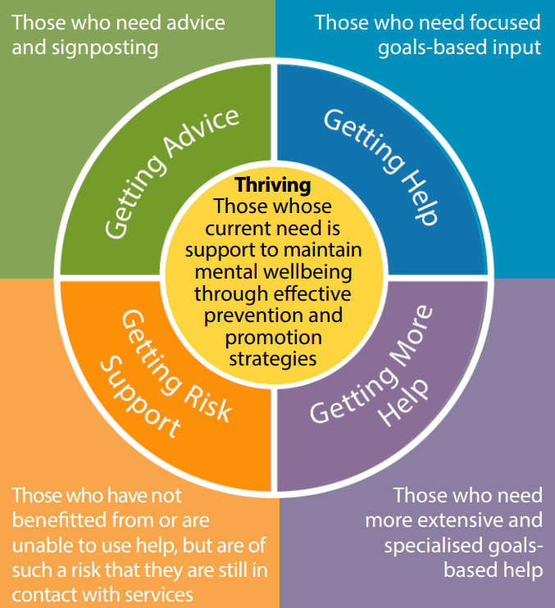
Bexley CAHMS Future clinical model: Helping our young people Thrive – Emotional Mental Health and Wellbeing advice and support

Slide 21
Principles of the THRIVE Framework
1. Common Language: The conceptual framework, and its five needs based groupings: Thriving, Getting Advice and Signposting, Getting Help, Getting More Help, Getting Risk Support, supports a shared language and understanding across the system.
2. Needs-Led: Approach based on meeting need, not diagnosis or severity. Explicit about the definition of need at any one point, what the plan is and everyone’s role within that plan. Fundamental to this is a common understanding of the definitions of the needs based groupings across the local system.
3. Shared Decision Making: Voice of children, young people and families is central. Shared decision making processes are core to the selection of the needs based grouping for a given child or young person.
4. Proactive Prevention and Promotion: Enabling the whole community in supporting mental health and wellbeing. Proactively working with the most vulnerable groups. Particular emphasis on how to help children, young people and their communities build on their own strength including safety planning where relevant.
5. Partnership Working: Effective cross-sector working, with shared responsibility, accountability and mutual respect based on the five needs based groupings.
6. Outcome-Informed: Clarity and transparency from outset about children and young people’s goals, measurement of progress movement and action plans, with explicit discussion if goals are not achieved.
- Discuss the limits and ending of interventions.
- Differentiate treatment and risk management.
- Consider full range of options including self or community approaches.
7. Reducing Stigma: Ensuring mental health and wellbeing is everyone’s business.
8. Accessibility: Advice, help and risk support available in a timely way for the child, young person or family, where they are and in their community.

Slide 22
Future Bexley
To reduce the number of referrals into Bexley CAMHS, both crisis and routine
The number of accepted referrals increased through Covid-19, to meet the demands based of this
The number of contacts for each child has increased, demonstrating an increase in complexity factors and clinical risks, incorporating two pro approach with integrating care being paramount.
The numbers of waiting assessment has increased, in line with the demand and complexity.

Slide 23
Thank You Any Questions?

